Slide 1

INTRODUCTION
PUSL2008

Slide 2
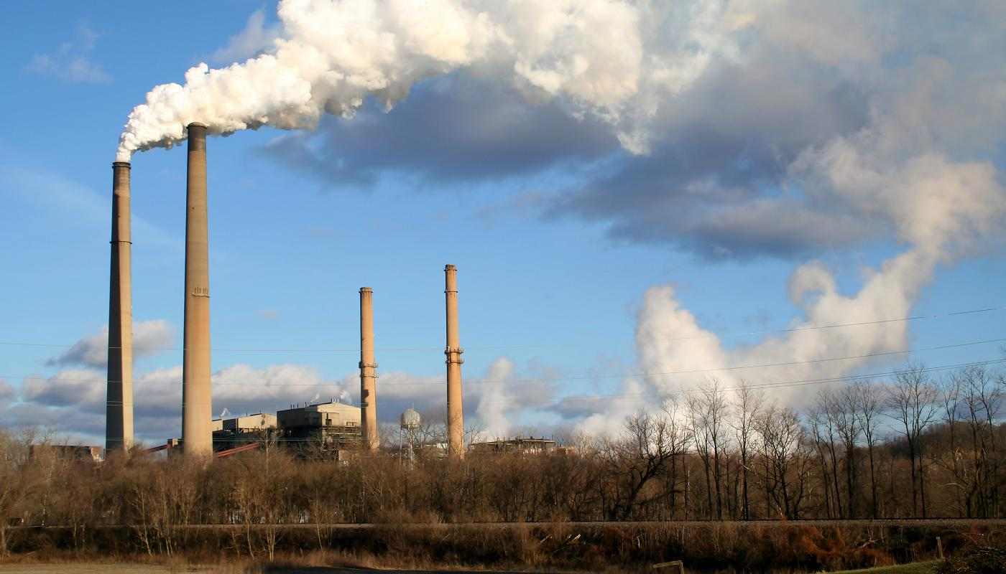
AIR POLLUTION MONITORING SYSTEM
PUSL2008

Slide 3





Overview
Real-time monitoring
Real-time alerting
User friendly interface
Easy to configure
Devices used

Slide 4



Real-time monitoring The system helps us to monitor these conditions in real time
Humidity
Temperature
Air quality

Slide 5

Real-time alerting This system will be making a alert if the following conditions come for a dangerous point
Temperature incensement above 35 C
Air quality becomes impure
There will be an alert for the android mobile application and via email.
Application used: Blynk

Slide 6
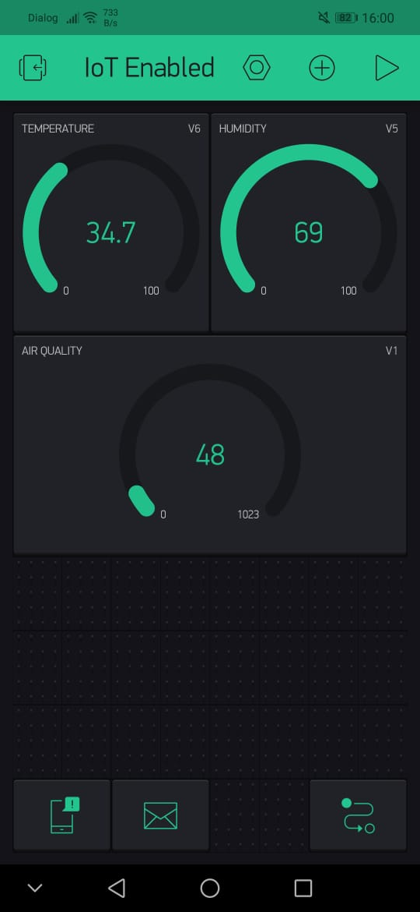
User friendly interface
Anyone with zero knowledge about computers and devices will be able to understand due to user friendly application

Slide 7


Easy to configure Easy to operate and configure by the user.
Client’s requirement will be easy to configure using the 230V power supply
Needed only small space

Slide 8
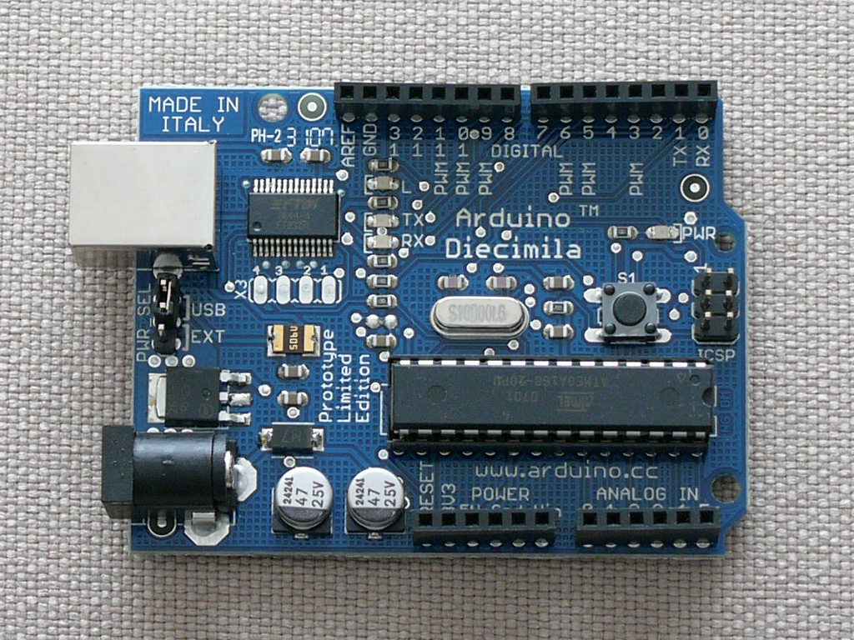
Devices used
Arduino UNO R3
Ethernet Shield
MQ135 Air Quality Sensor
DHT11 Temperature and Humidity Sensor
Buzzers and Lights to Indicate the Changes
3A 12V Power Adapter
Components and parts used for the project

Slide 9
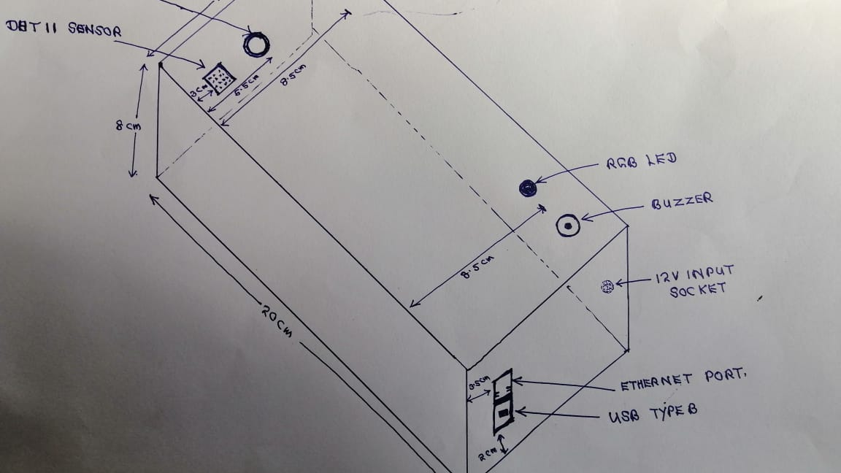
Proposed system unit (Measurements)

Slide 10
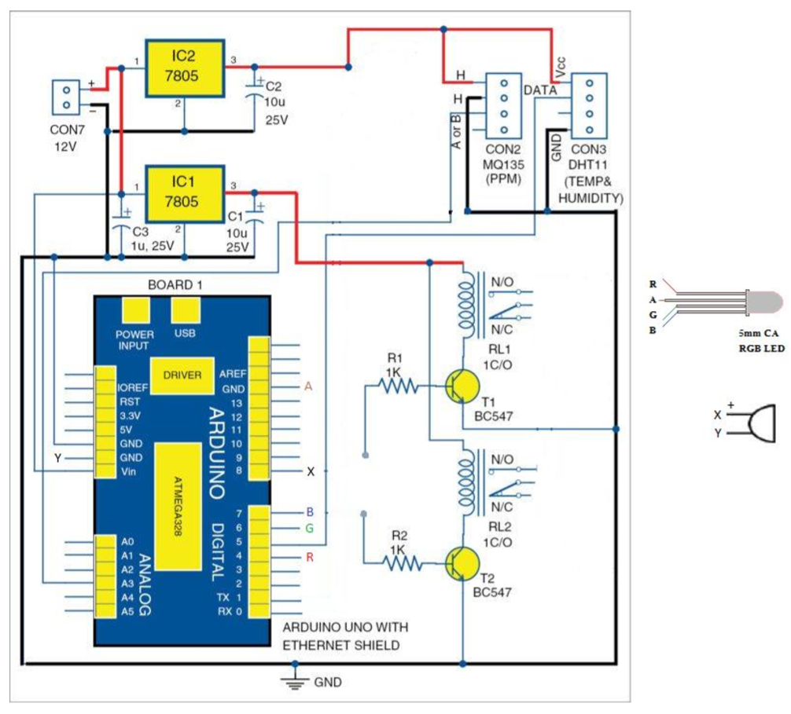
Circuit diagram

Slide 11
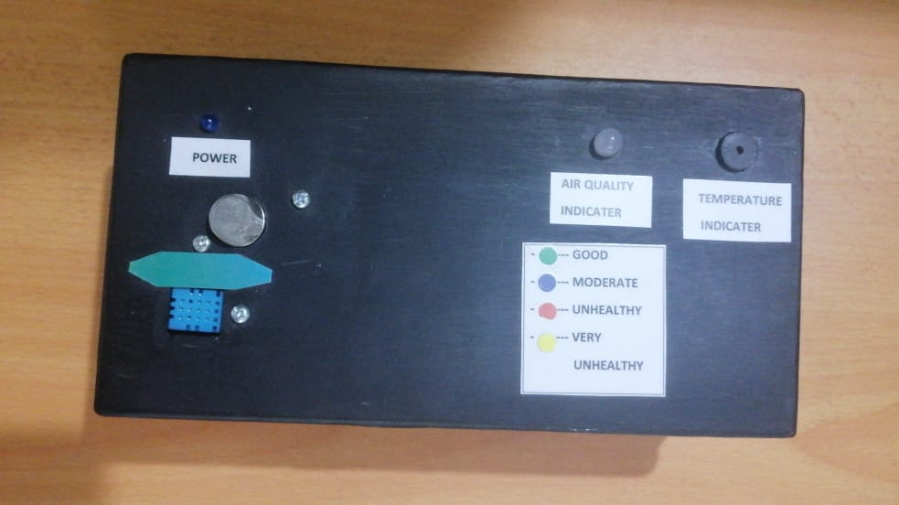
Completed system (Top view)

Slide 12
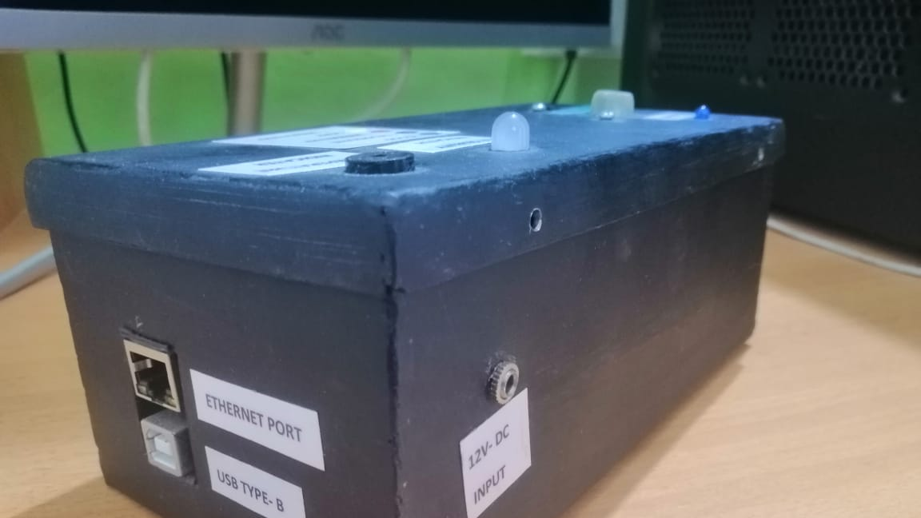
Completed system (Side view)

Slide 13
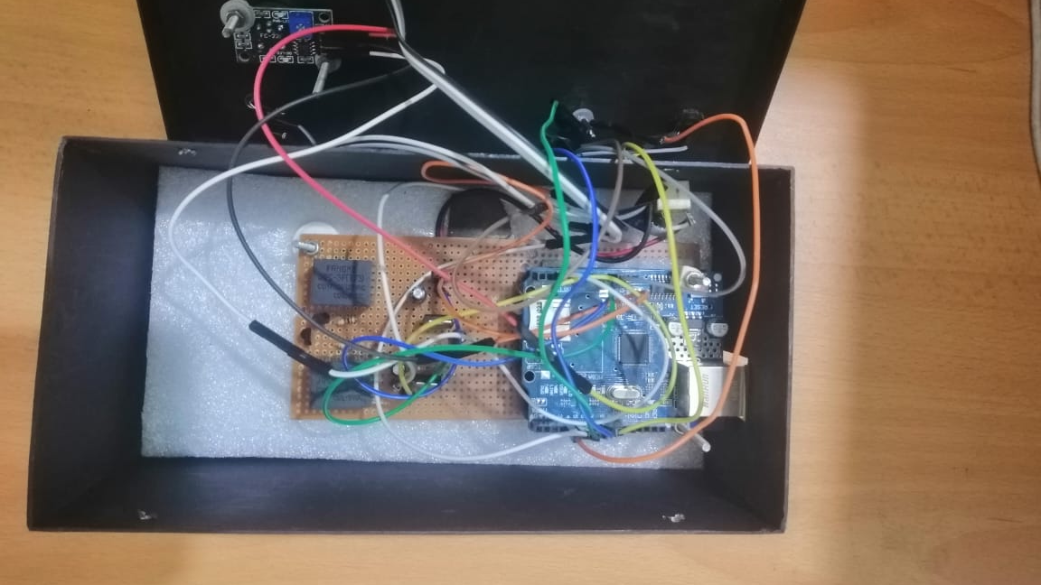
Completed system (Internal view)

Slide 14

Kevin Samaraweera
Chamath Mihindu
Sachin Jayakody
TEAM
Malith Priyashan
Mithila Eashani

Slide 15






Thank You
Kevin Samaraweera
+94 770161240
kevinreborn98@gmail.com
dkchabba98@gmail.com

